Slide 1

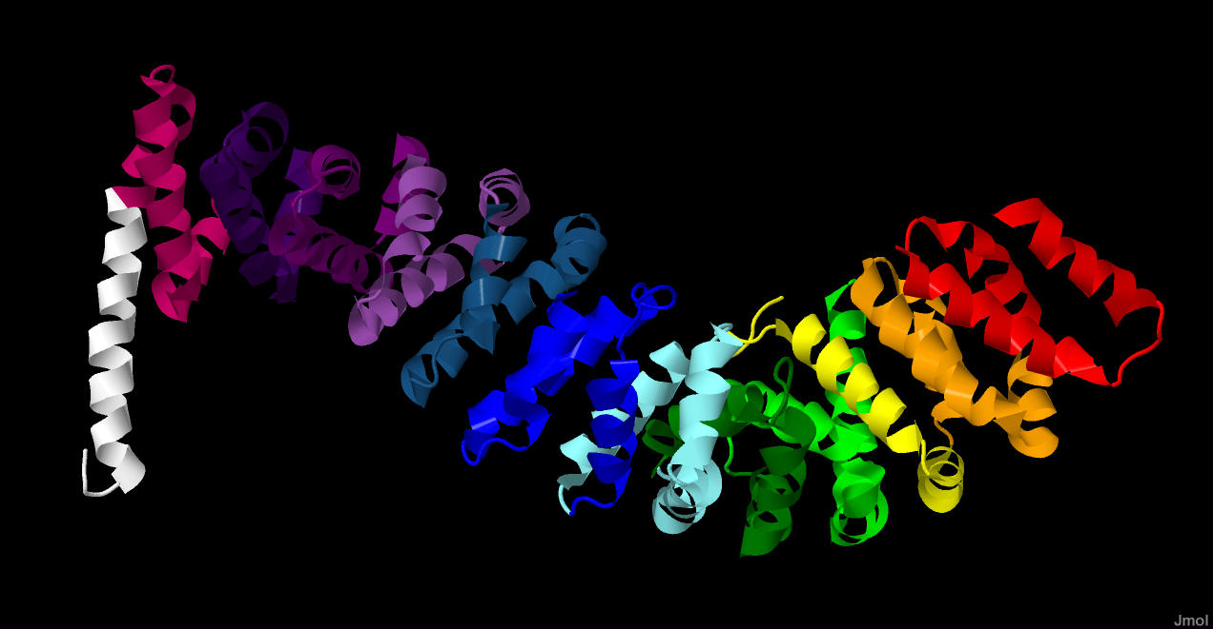
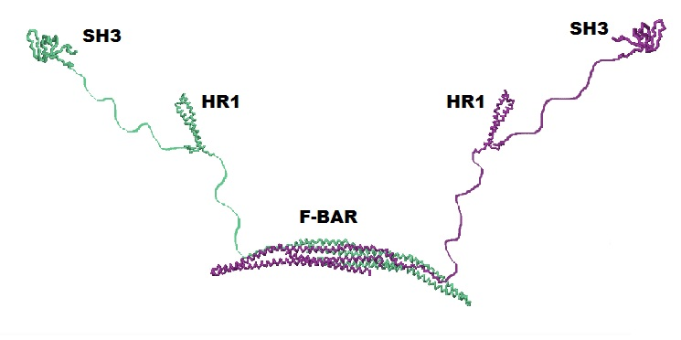
CREST UW-Madison Partnership
Devan Van Lanen – Wanek
Michelle Harris
Biocore, UW – Madison

Slide 2
Project conception
Goal: facilitate partnerships between UW-Madison faculty, instructional staff, and undergraduates to develop physical molecular models/curricular materials
      -Models help connect faculty research with undergraduate instruction
Two UW-Madison CREST teams
  β-CATENIN – Amy Moser and Jeff Hardin
  F-BAR – Erik Dent

Slide 3
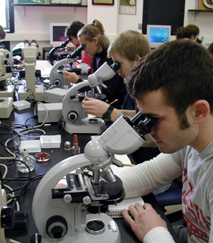
Biocore
4 semester honors biology program
Broad, in-depth, and integrated knowledge
Emphasis on problem solving, critical thinking, research, writing, and the process of science

Slide 4
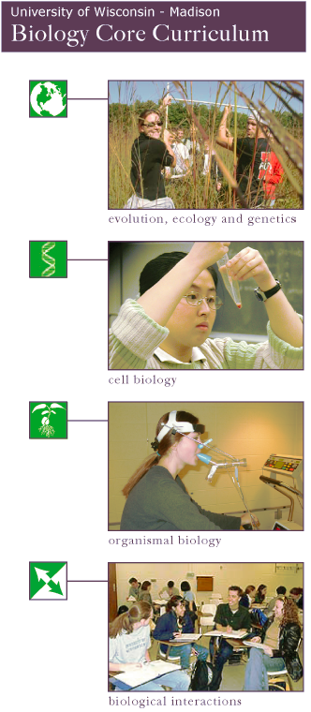
Biology Core Curriculum
(Biocore)
~120- 150 students/ year
Freshman courses: chemistry & math
Biocore 301/302- Evolution, Ecology and Genetics
Upper level
courses
*********
~35 different biological science majors
Biocore 303/304- Cell Biology
Biocore 323/324- Organismal Biology
Biocore 333- Biological Interactions (capstone)
Notes:
Biocore is a four semester integrated biology curriculum particularly well suited for those students who are interested in research and inquiry– it is one of three sequences a biological science major can take to fulfill most biology requirements.
Students typically enter Biocore in their sophomore year after completing prerequisite chemistry and math courses. Approximately 120-150 students enter the program each fall and complete courses the following lecture and lab courses as a cohort- learning community-while also taking upper level courses for their major field of study (lots of biology and biochemistry students).
They receive honors level course credit.
Biocore is distinguished from other introductory biology course sequences (Biology 151/152; Zoology 101/102 and Botany 130) by its
1.) its two-year structure,
2.) integrate course material over multiple semesters,
3.) emphasis on research and the process of scientific discovery,
4.) high student-instructor contact
5.) cohesive student learning community [heavy emphasis on Group and community– low competition!], and
5.)transition from introductory to intermediate course content
We began this study in order to provide a more rigorous evaluation of student learning gains associated with genetics and to identify variables related to student success.

Slide 5
CREST Project Focus
~120- 150 students/ year
Freshman courses: chemistry & math
Biocore 301/302- Evolution, Ecology and Genetics
Upper level
courses
*********
~35 different biological science majors
Biocore 303/304- Cell Biology
Biocore 323/324- Organismal Biology
Biocore 333- Biological Interactions (capstone)
Notes:
Biocore is a four semester integrated biology curriculum particularly well suited for those students who are interested in research and inquiry– it is one of three sequences a biological science major can take to fulfill most biology requirements.
Students typically enter Biocore in their sophomore year after completing prerequisite chemistry and math courses. Approximately 120-150 students enter the program each fall and complete courses the following lecture and lab courses as a cohort- learning community-while also taking upper level courses for their major field of study (lots of biology and biochemistry students).
They receive honors level course credit.
Biocore is distinguished from other introductory biology course sequences (Biology 151/152; Zoology 101/102 and Botany 130) by its
1.) its two-year structure,
2.) integrate course material over multiple semesters,
3.) emphasis on research and the process of scientific discovery,
4.) high student-instructor contact
5.) cohesive student learning community [heavy emphasis on Group and community– low competition!], and
5.)transition from introductory to intermediate course content
We began this study in order to provide a more rigorous evaluation of student learning gains associated with genetics and to identify variables related to student success.

Slide 6
Biocore 333: Biological Interactions
Explore 4 topics through primary literature research papers
Evaluate experimental design, comprehend the science behind the methods and techniques
Interconnection of biological systems and integration of knowledge from past courses

Slide 7
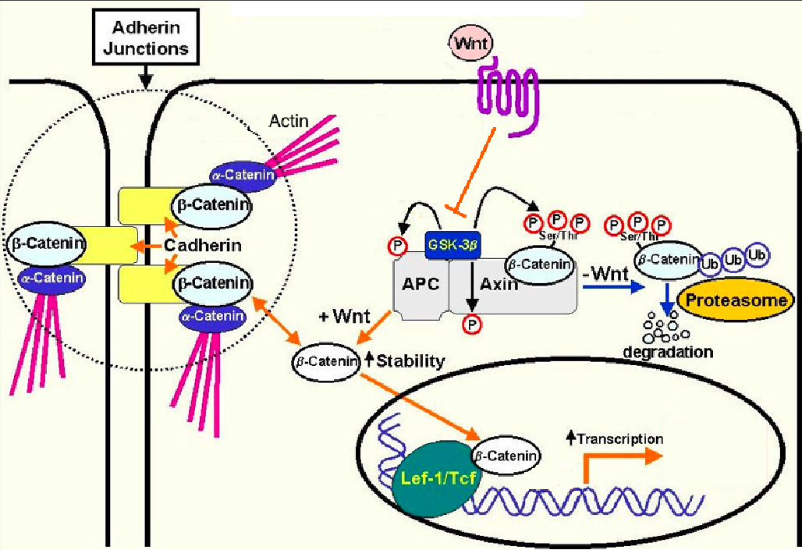
Developing new materials
Biocore 333 topic: APC and colon cancer
  β-catenin as cellular proto-oncogene

Slide 8
Learning Goal
Students will describe mutations or changes that need to occur in the proteins in a pathway for deregulation to occur

Slide 9
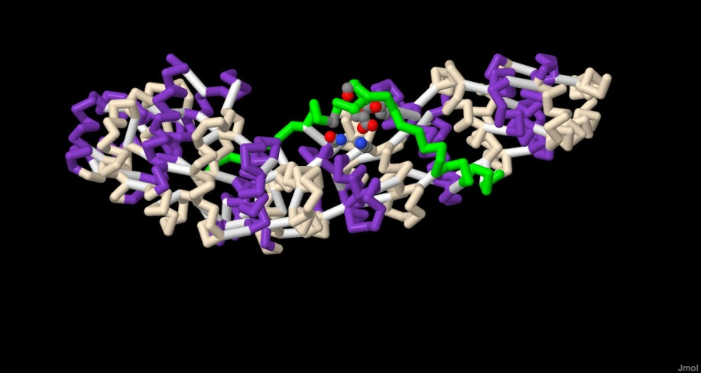
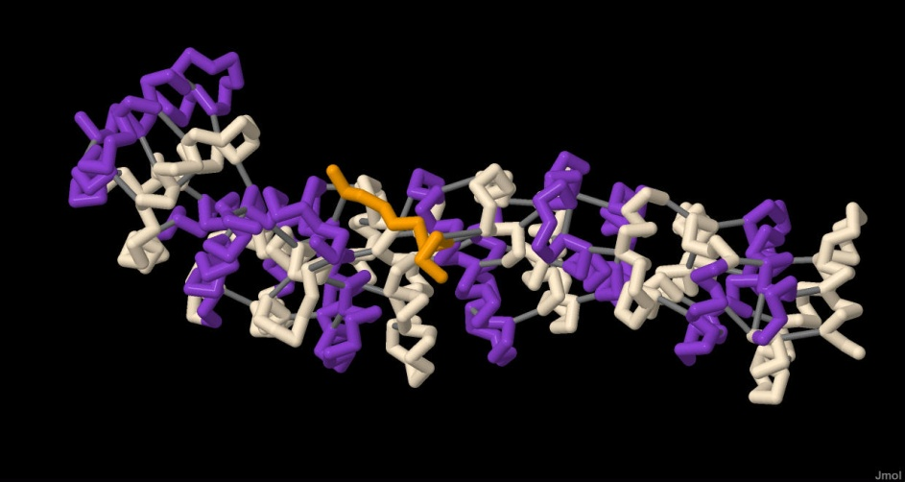
Developing new materials
Use physical models & and other educational materials to help students achieve learning goals
  Worksheet and exam questions for evaluation
  Using data to assess efficacy of physical models/ curricular materials in learning
1JDH – with TCF-4
1JPP – with APC

Slide 10
Curricular details
Puzzle activity in discussion, early April 2012
  WNT present, WNT absent, β-CATENIN from tumor, APC from FAP patient
Models to be used in review session in May 2012
  Models show that the interaction domain for APC, E-caderin and TCF is the same

Slide 11
β-catenin Evaluation details
Pre- and Post-SALG
Worksheet question: previously groups often answered wrong
  “You then decide to screen for mutations in the β-catenin gene. Describe the types of mutations you would expect to find and explain how they would affect the function of the protein. “
    Preliminary data: Only 3 of 18 groups got the question wrong!
Exam question about types of mutations in β-catenin gene that would lead to tumor development – individual assessment

Slide 12
CREST Project Focus
~120- 150 students/ year
Freshman courses: chemistry & math
Biocore 301/302- Evolution, Ecology and Genetics
Upper level
courses
*********
~35 different biological science majors
Biocore 303/304- Cell Biology
Biocore 323/324- Organismal Biology
Biocore 333- Biological Interactions (capstone)
Notes:
Biocore is a four semester integrated biology curriculum particularly well suited for those students who are interested in research and inquiry– it is one of three sequences a biological science major can take to fulfill most biology requirements.
Students typically enter Biocore in their sophomore year after completing prerequisite chemistry and math courses. Approximately 120-150 students enter the program each fall and complete courses the following lecture and lab courses as a cohort- learning community-while also taking upper level courses for their major field of study (lots of biology and biochemistry students).
They receive honors level course credit.
Biocore is distinguished from other introductory biology course sequences (Biology 151/152; Zoology 101/102 and Botany 130) by its
1.) its two-year structure,
2.) integrate course material over multiple semesters,
3.) emphasis on research and the process of scientific discovery,
4.) high student-instructor contact
5.) cohesive student learning community [heavy emphasis on Group and community– low competition!], and
5.)transition from introductory to intermediate course content
We began this study in order to provide a more rigorous evaluation of student learning gains associated with genetics and to identify variables related to student success.

Slide 13
Biocore 303: Cellular Biology
Learning Goal #1: Understand that endocytosis requires several different proteins & explain/ recognize/predict how this affects endocytic shape
Learning Goal #2: State a hypothesis/draw a diagram about how an protein’s activation affects its function in different cellular processes
Learning Goal #3: Understand that “1 protein ≠ 1 function”. Students will recognize/ predict/ graph protein function based on cell location & other molecules present

Slide 14
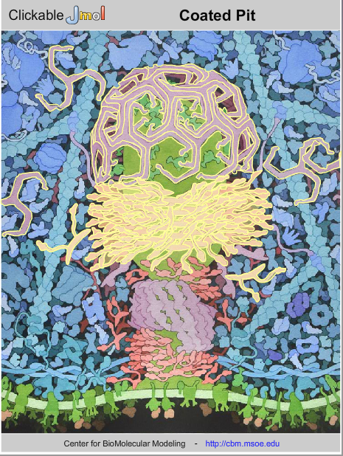

Curricular details
Clickable landscape used by
all students as part of graded homework assignment

Slide 15

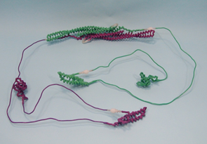
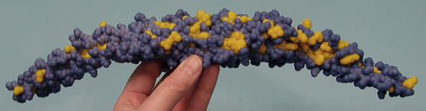
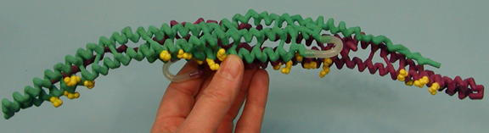
F-BAR models used by half of discussion sections as they do homework

Slide 16
F-BAR Evaluation details
Pre- and Post-SALG
Graded homework
Final exam questions about novel protein: predicting function from structure & location

Slide 17
Project Challenges
Challenges of evaluating efficacy of physical model & puzzle activity
  Difficulty of dividing students into control and experimental groups in one class
  Inability to use past student data
Time!! (e.g., no time for Jmol tutorial)
TA training
Restricting online materials to treatment groups
IRB (‘nuff said)

Slide 18
Happy Stuff
Engagement of faculty with undergraduates
F-BAR publication from Dent lab with CREST undergrad as second author
New research directions in Dent lab, partly inspired by modeling project
Undergraduates experience curricular design

Slide 19
Future plans
Recruit new Biocore students to work with faculty to develop models & curricular materials
Revise curricular materials & assessment plan for spring 2013
Publications
  Erik Dent – reflection piece
  CBE-Life Science Education manuscript??

