Slide 1
CREST Research and Teaching Symposium
April 28, 2012
Milwaukee School of Engineering

Slide 2
NSF CCLI #1022793
Second year of 3 year grant
Application for renewal of funding in January 2013
The Proposal vs. The Project

Slide 3
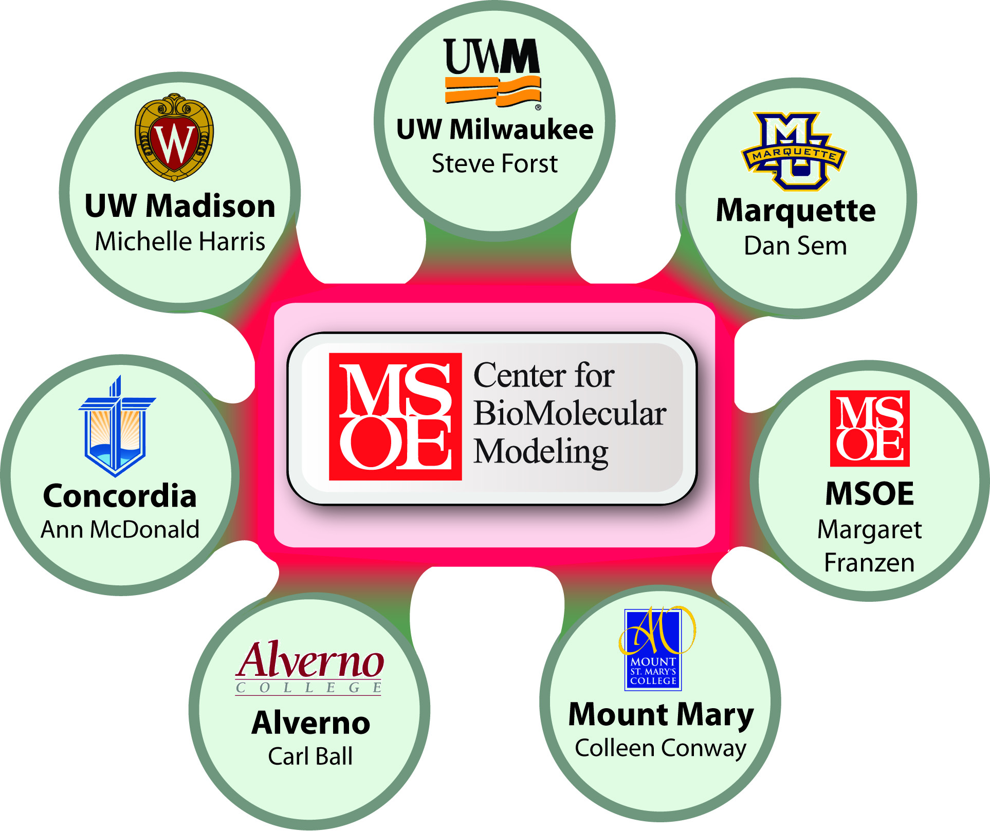

Slide 4
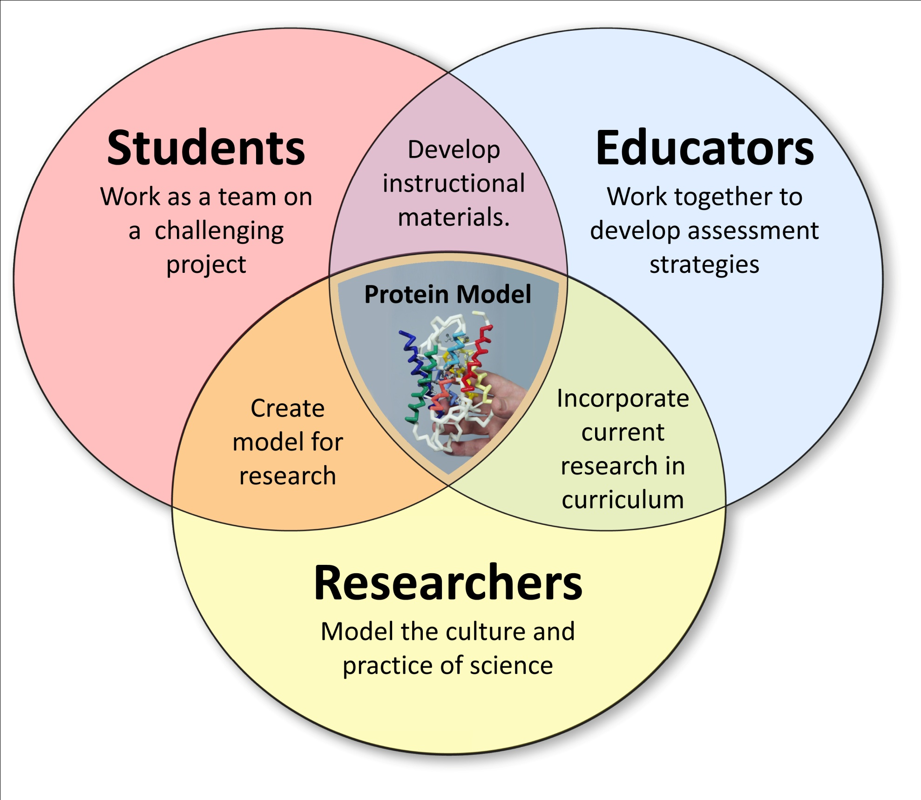

Slide 5
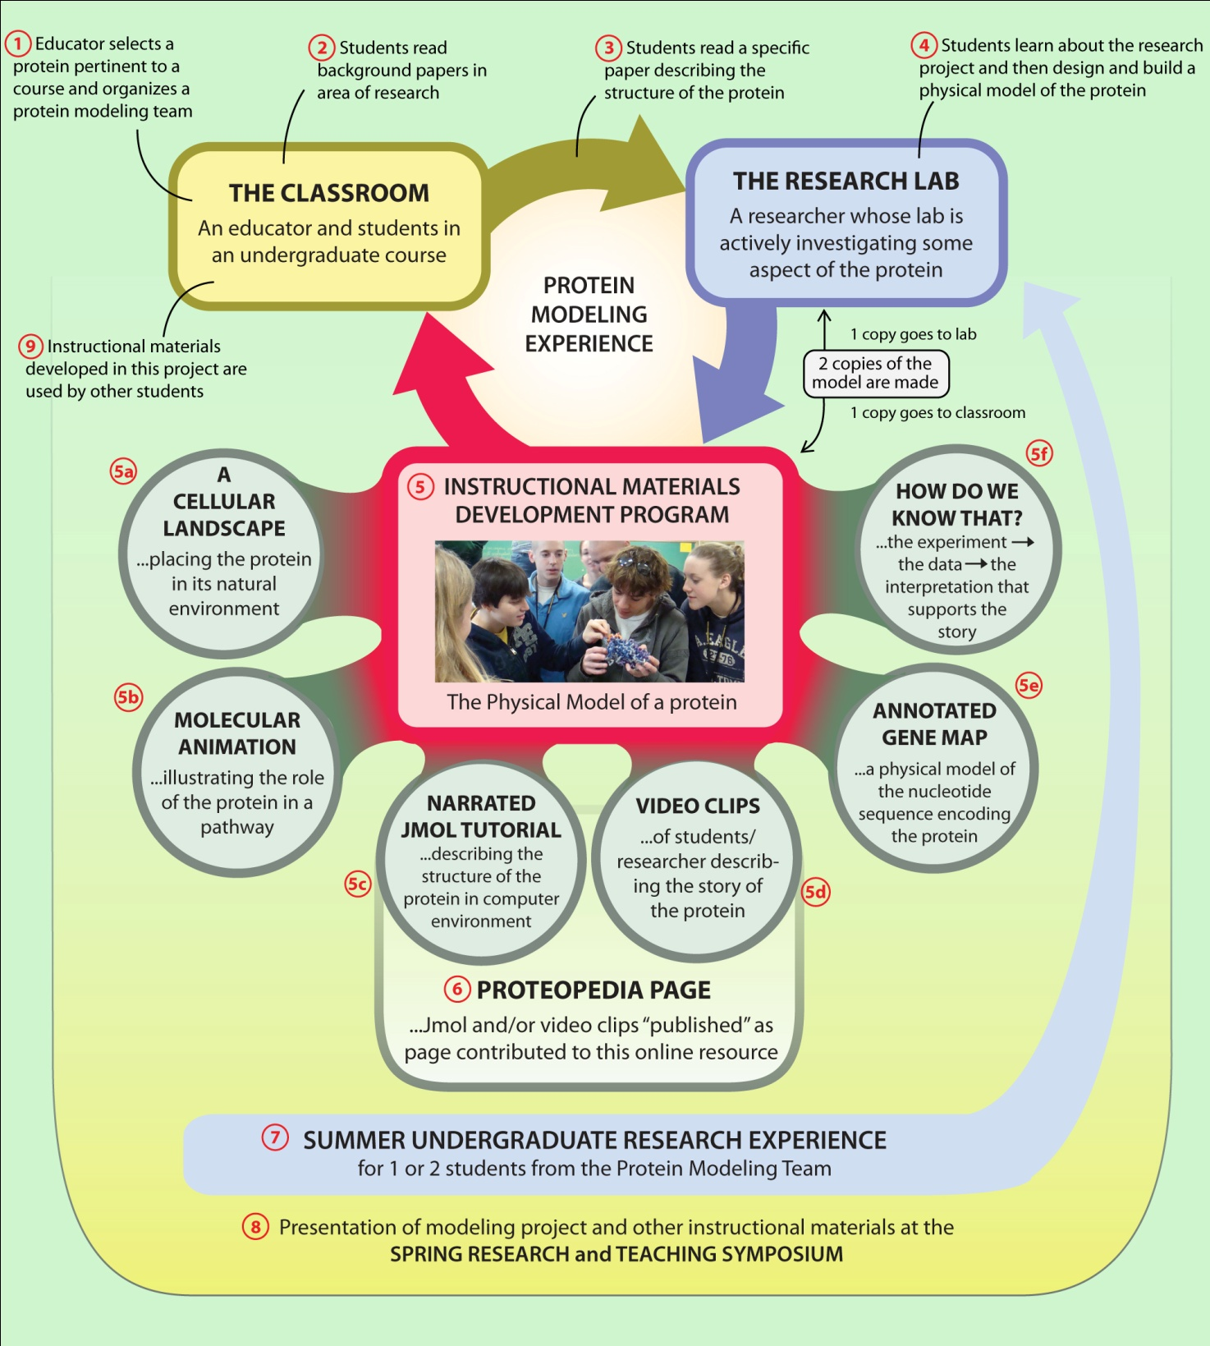

Slide 6
Goals for Educators
Educators will develop and incorporate more active, student-centered activities into their classrooms.
Educators will incorporate more current research findings into their classrooms.

Slide 7
Goals for Students
Students will be more reflective regarding their learning.
Students will better describe the roll of research in generating new knowledge.
Students will participate productively in science practices and discourse.
Students will become more confident in their ability to succeed in a career in science.

Slide 8
Goal for Educators and Students
Both educators and students will become active members of a common community of learners – sharing the excitement of discovery.

