Slide 1
Design of soluble epoxide hydrolase inhibitors as drug leads
Junghwa Kim, Elise Pellmann, Mike Wild
Daniel Sem, Ph.D. John Imig, Ph.D.

Slide 2
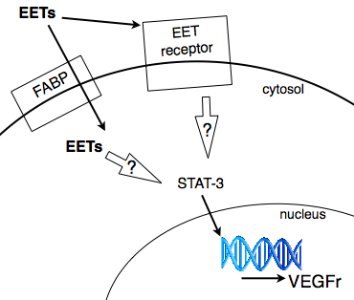
sEH: biology
Epoxyeicosatrienoic acids (EETs)
Cytochrome P450
Vasodilation, anti-inflammatory, angiogenesis
sEH inhibition

Slide 3
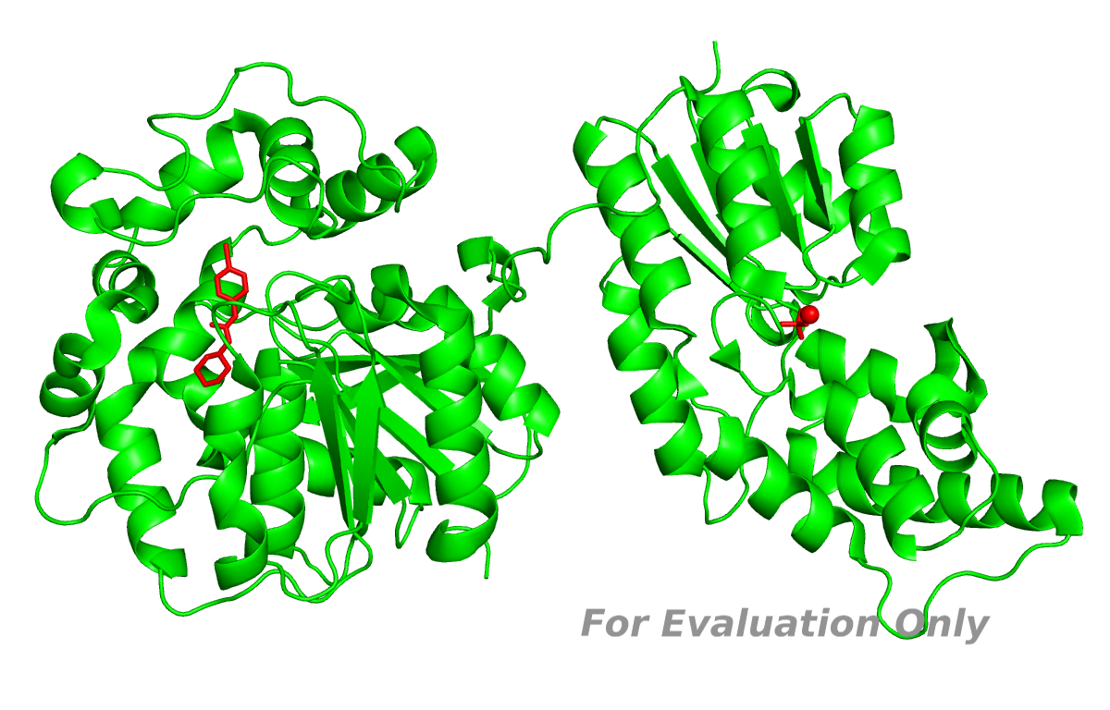
sEH: biochemistry
Two domains:
hydrolase (N-terminal), phosphatase (C-terminal)

Slide 4
sEH As a Teaching Example Hydrolysis of Epoxides, Enzyme Activity, Catalytic Triad

Slide 5
Imig Group Experiment
Development of EET Analogs
Studied Male Rats
Renal Effects
Blood Pressure/Heart Rate
Most Promising Lead- 11,12-ether-EET-8-ZE

Slide 6
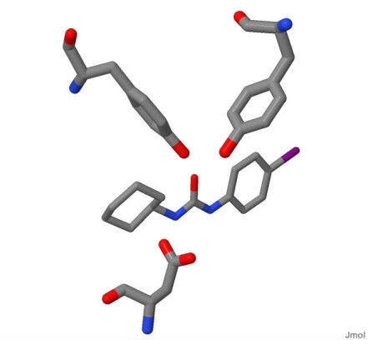
Inhibitor Design
Study of 1VJ5 Crystal Structure
Jmol and Swiss Viewer
Propose Drug Leads
Draw in ChemDraw
From Swiss Viewer

Slide 7
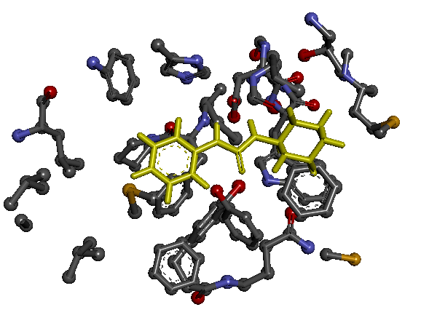
Inhibitor Design
Draw Structure of Drugs in Spartan
Place designed drugs on Enzyme (sEH) through Discovery Studio Visualizer

Slide 8
What’s next?
Kinetic assays (in vitro):
Determine K_{d}, mode of inhibition
ADMET (in vivo, in silico)
In silico: docking, TOPKAT (accelrys)

