Slide 1



Simon Duri
Xixi Hong
Joseph Lustig
Aleksandra Porebska
C-Src Kinase Inhibition:
A Promising Route in Kidney Cancer Treatment

Slide 2
Outline
Overview of c-Src
Activation/VEGF pathway
A recent experiment involving c-Src and Bosutinib
Designing potential drug molecules
Applications of c-Src in teaching Biochemistry
Conclusion

Slide 3
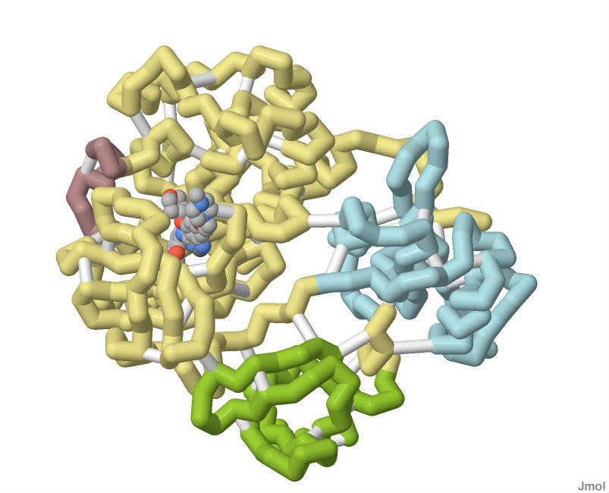
Overview
C-Src kinase is a non receptor tyrosine kinase, encoded by the c-Src (cellular-Src) gene (Src pronounced “sarc”, which is short for sarcoma, a cancer type which derives from changed connective tissue cells)
C-Src protein acts as a signal transduction inhibitor that is a critical component of multiple signaling pathways that control cell growth, proliferation, invasion, and apoptosis
However, c-Src is involved in a number of signaling pathways that ultimately lead to angiogenesis. Recently derived data leads to deduction that the most important consequence of increased c-Src activity is promotion of an aggressive phenotype.

Slide 4
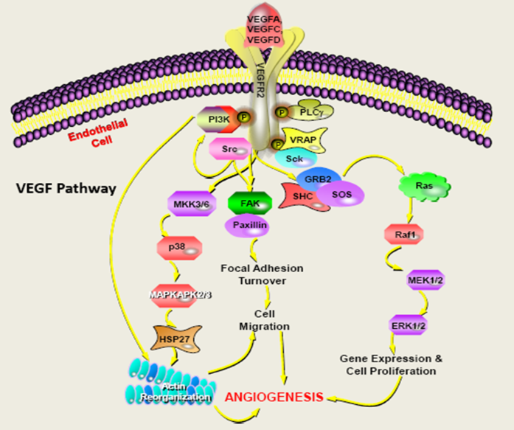
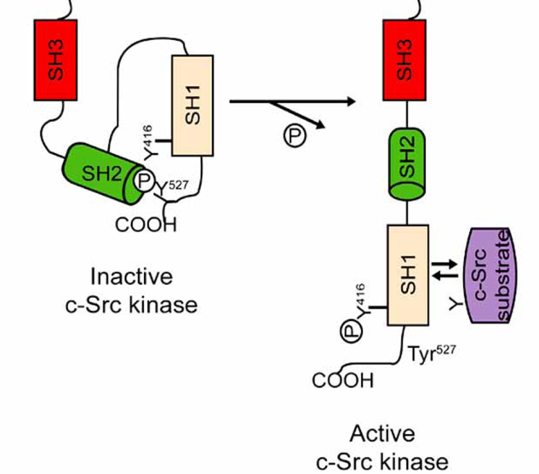
Activation/VEGF
One of the signaling pathways that c-Src is involved in is the VEGF (Vascular Endothelial Growth Factor)
Involment of c-Src in the VEGF pathway
SABiosciences, ProteinLounge.com
Auto phosphorylation & Activation of C-Src
Rucchi N et al, Anti-cancer agents in Med Chem, 2008, 8, 342
In the inactive form of c-Src, Tyr527 is phosphorylated and binds to the SH2 domain
Tyr416 is dephosphorylated, and the SH3 domain is engaged with the SH2 kinase linker.
C-Src is activated by dephosphorylation of Tyr527 which leads to an “open” conformation, allowing autophosphorylation of Tyr416 and interaction of c-Src with substrates

Slide 5
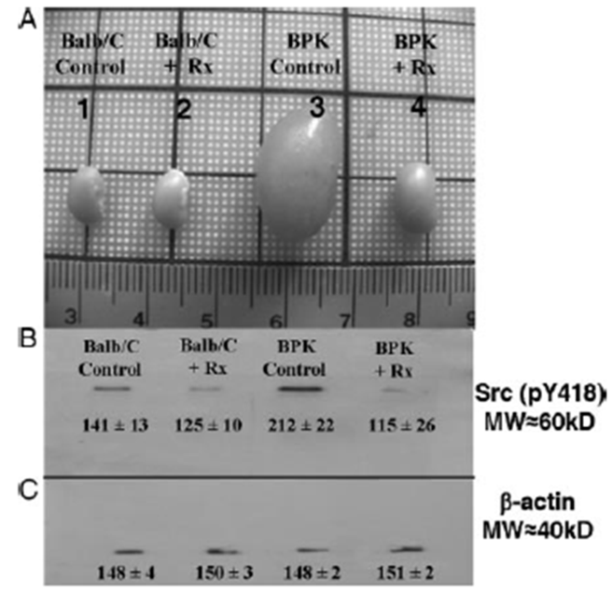
Recent Experiment
Inhibition of c-Src can be used as a way of regulating cell growth, ultimately resulting in cancer treatment. Dasatinib and Bosutinib are some examples of drug compounds that inhibit the autophosphorylation of c-Src, resulting in inhibition of cell growth and apoptosis .
Boschelli DH, Boschelli F. Bosutinib Drugs Fut. (2007) 32 (6): 481.
Effect of c-Src and treatment with SKI-606 on renal size
J. Am. Soc. Nephrol, 2008, 19: 1331 - 1341
Bpk (cystic) and BALB/c pups received SKI-606 (Bosutinib) at 30 mg/kg per day by i.p., starting at PN7 (postnatal day 7). Animals were treated from PN7 to PN20 (14 doses). Kidney tissues were routinely harvested at PN21.
Reduction in renal Src activity with SKI-606 treatment results in significant reduction in cystic kidney size.

Slide 6
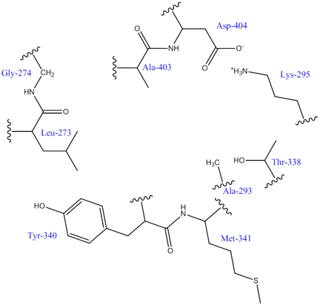
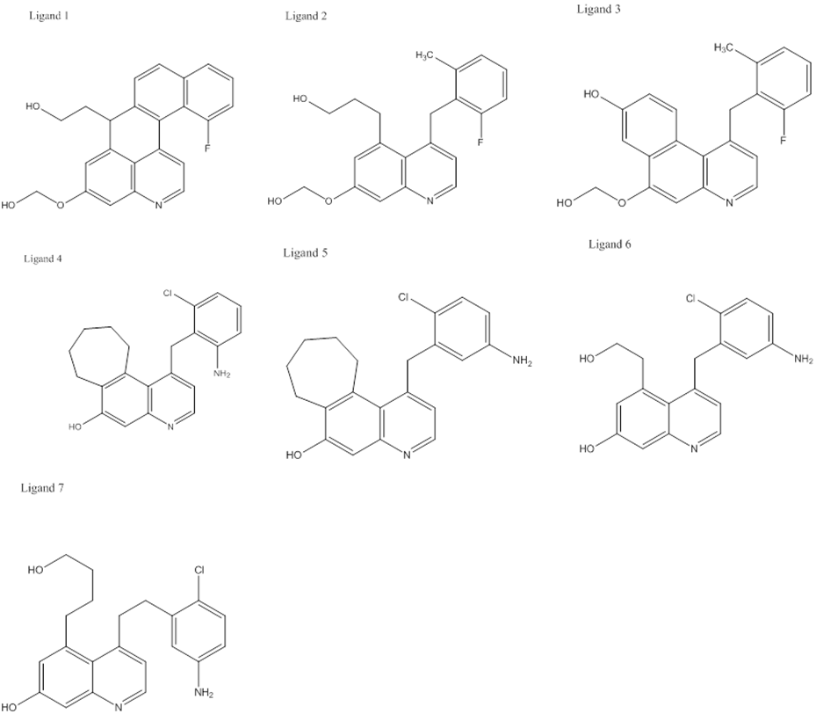
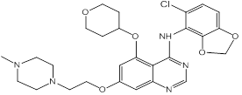
Drug Design
Some of the ligands designed as possible drug
molecules targeting c-Src, using the known
inhibitor AZD0530 as a starting point.
2D active site of c-Src showing the amino acid residues
AZD0530

Slide 7
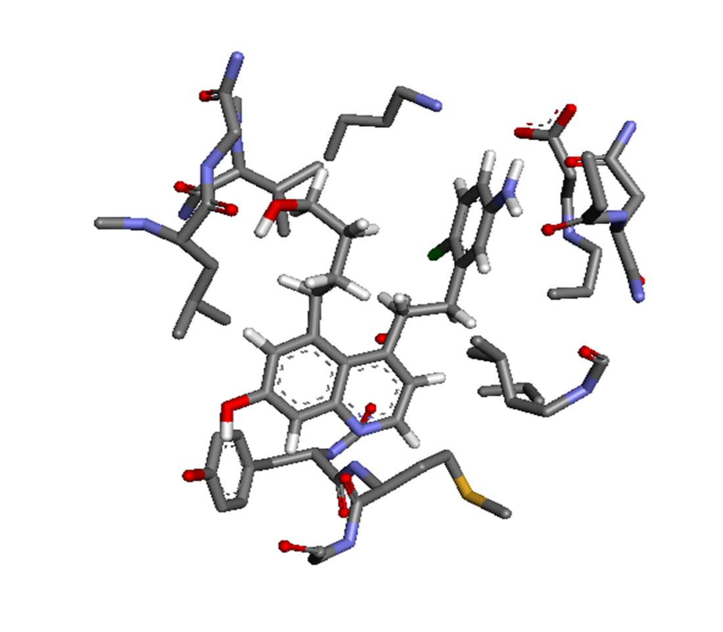
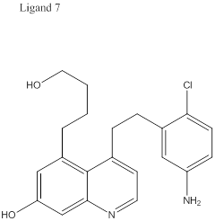
Insertion of these ligands in the protein active site and visualization of possible interactions with amino acid residues using software packages such as Discovery Studio Visualizer are very useful in optimizing the structures of the possible drug molecules. Example:
Example above: 3D active site of c-Src, the interactions of Ligand 7 in the active site of c-Src

Slide 8
C-Src and teaching Biochemistry
Src & Inhibitor
The application and combination of different software programs,
such as ChemDraw, Jmol, Discovery Studio Visualizer and so on
can be taught with this molecule
The visualization of the interactions for ligands and active sites
shows the rules of interaction between the ligands and
enzymes and teach us: these interactions include H bonds,
pi – cationic interactions and hydrophobic interactions.
C-Src can be used to teach the concept of protein inhibition and the role of ligands
Concern health, cherish life. Src is just a noun, but cancer and health are not!

Slide 9
Conclusion/Future
There are already a number of drug molecules targeting c-Src. Example: The results of Bosutinib on the size of kidney in mice clearly show the effectiveness of targeting c-Src in cancer treatment.
Insertion of ligands in the protein active site and visualizing possible interactions with amino acid residues using software packages such as Discovery Studio Visualizer is very useful in optimizing the structures of the possible drug molecules.
However, further work will have to be done to determine parameters such as binding constants (increasing the binding affinities) and toxicity of those molecules that would have been selected
.

