Slide 1
MODELING AND INHIBITION OF VEGF-C/VEGFR2 ACTIVE SITE
Mohamed El Mansy
Matthew Flister
Denan Wang
Under supervision of
Professor Daniel Sem

Slide 2
INTRODUCTION
oxygen and nutrients
Targeting VEGF is a promising anti-cancer treatment.
Blood
Tumors
chemotherapy and other drugs
VEGF
Angiogenesis
Anti apoptosis

Slide 3
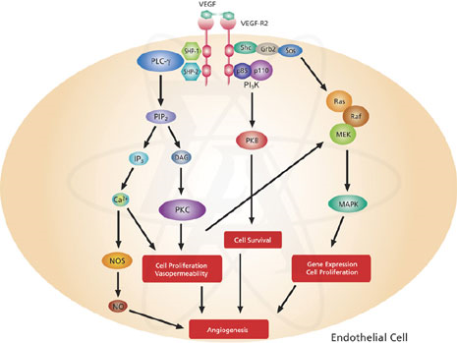
http://www.sigmaaldrich.com
Several signaling pathways are activated by VEGFR2, including the PI 3- kinase/Akt pathway and MAP kinases such as ERK1 and ERK2

Slide 4
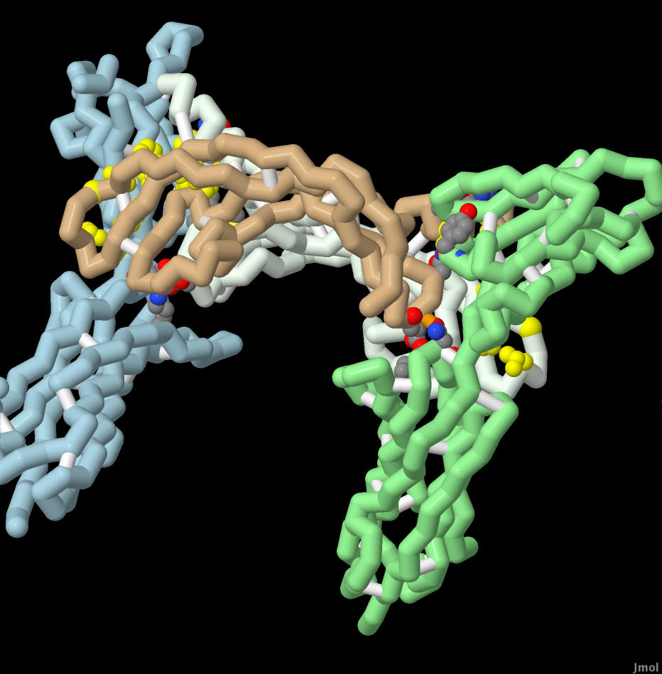
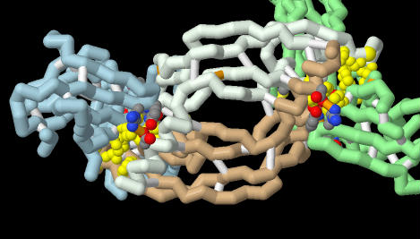
Protein Structure
VEGF-C/VEGFR2
Complex of four domains, two
VEGFR2 bound to VEGF dimer
VEGF-C
Anti-parallel homodimer,
two cysteine disulfide bonds

Slide 5
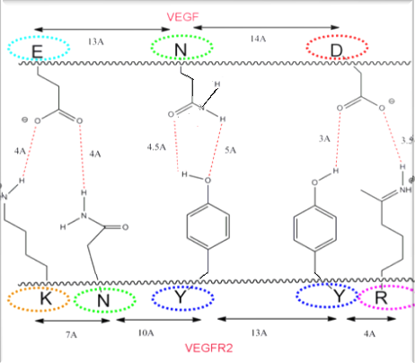
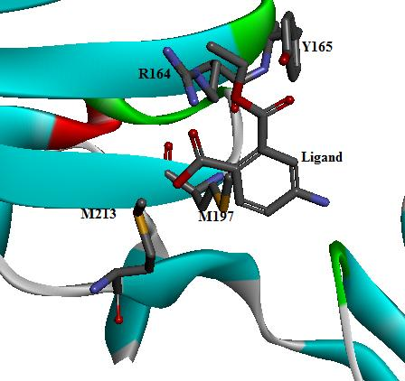
Active Site
Notes:
Lysine, Asparagine hydrogen bond donors
Tyrosine hydrogen bond donor Tyrosine, Arginine hydrogen bond donors
Approximately 34Å in width

Slide 6
LIGANDS DESIGN
Notes:
Spartan ST v2.0.0 , all the designed ligands were geometrically optimized at Hartree-Fock level of theory using 3-21G basic set.
Chemoffice2006 (chem3D & chemdraw) to draw chemical structure.
Web site: http://zinc.docking.org a free database of commercially-available compounds for virtual screening.

Slide 7
Future work
Dr. Wilkinson’s lab has recently been working on whether a second gene influences how well VEGF can activate its receptor (KDR).
They can then use protein called ECSCR measure sensitivity to VEGF.
Future research in anti-VEGF therapies will most likely combine anti-tumor therapy with anti-VEGF treatment at the correct dosage and time.

Slide 8
Thank you

