Slide 1
Proposing Ligands and an Active Site in NgBR for Cancer Treatment
Geng Lee, Anna Weber, Qianhong Zhu

Slide 2
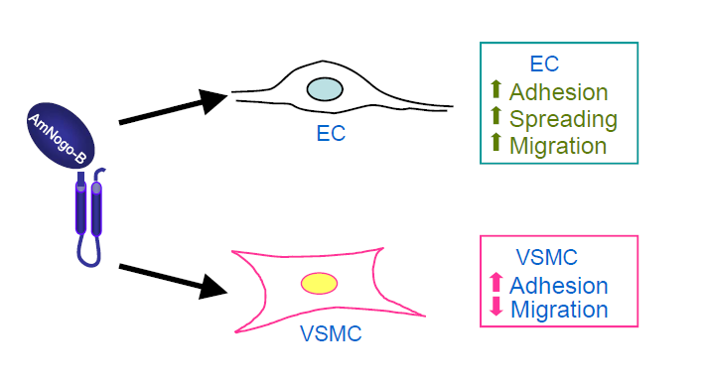
NgBR in the body
NgBR is found in the endothelial cells (EC)
NgBR is important in vascular endothelial growth factor (VEGF) migration
NgBR hinders the movement of vascular smooth muscle cells (VSMC)
NgBR binds to the Farnesyl group of Ras. Interactions between NgBR and the Farnesyl ligand of Ras may promote the growth of cancerous cells.

Slide 3
NgBR deficiency leads to reduced VEGF function
Control No Nogo-B (severe defect) No NgBR (severe defect)
whole
trunk
B. Zhao et al, Blood. 116 24 5427 2010
Severe defects in the formation of intersomitic vessels (ISV, yellow arrows) were seen by knocking out either Nogo-B or the NgBR

Slide 4
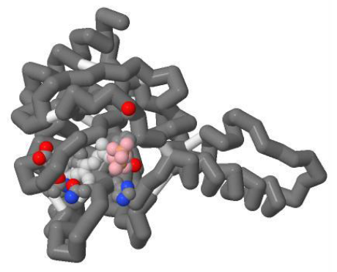
Jmol model of NgBR
EE-FPP
The interactions between the ligand and the pocket are mainly van der Waals interactions. We found Ser 115, Glu 107 , Gln 110, Tyr 135 and His 137 can form H-binding with the ligand we designed.
Glu 107
Gln 138
His 137
Gln 110

Slide 5
Ligand Creation

Slide 6
Future Work
Dr. Maio: Determine the active site of NgBR.
We: synthesize a ligand we designed and find out the bonding with the NgBR
Determine the structure

Slide 7
Homology Modeling as a Teaching Tool
The NgBR was based on a theoretical model
How is a homology model made?
Benefits of homology models
Notes:
Our work can help teach how homology models are made. We knew the sequence of the NgBR and used the protein Farnesyl diphosphate as the template. The homology structure of Farnesyl Diphosphate with the NgBR gave us an idea of possible essential amino acids located in the active site of NgBR. Using this information, ligands can be created that will bind the active site. Overall, using theoritical structures may lead to creation of ligands for protens.

