Slide 1
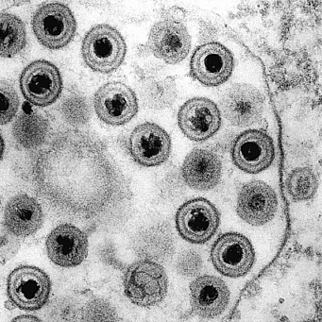
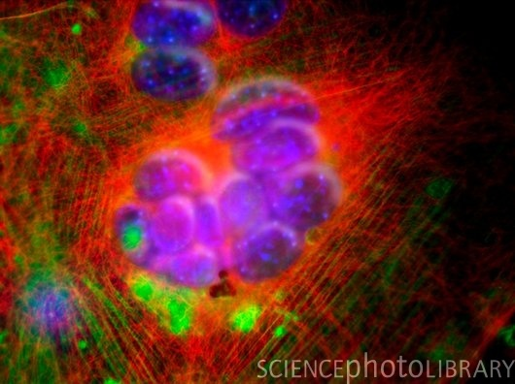
Major Histocompatibility Complex - Class I HLA-A2 and Presentation of HERPES Viral Peptides
Joshua Nord
Lora Rapp
Nathaniel Wanish
Concordia University of Wisconsin

Slide 2
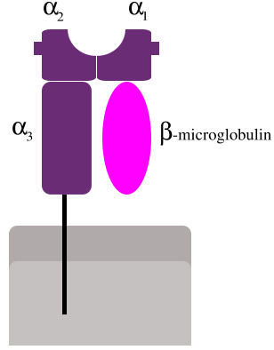
Big Picture
Human immune system
- Cytotoxic T lymphocytes (CTL)
- Viral peptide presentation
Major Histocompatibility Complex Class I (MHC)
-structure
Human Herpesvirus-7

Slide 3
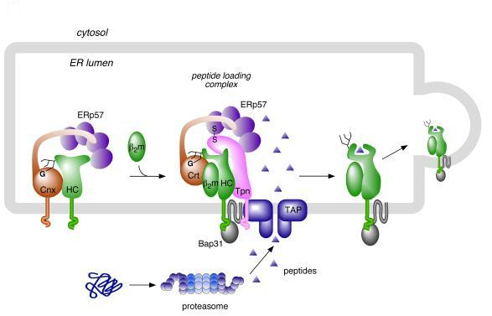
Class I MHC Formation
Synthesis
Cnx = Calnexin
HC = MHC α-chain
Crt = Calreticulin
Tpn = Tapasin

Slide 4
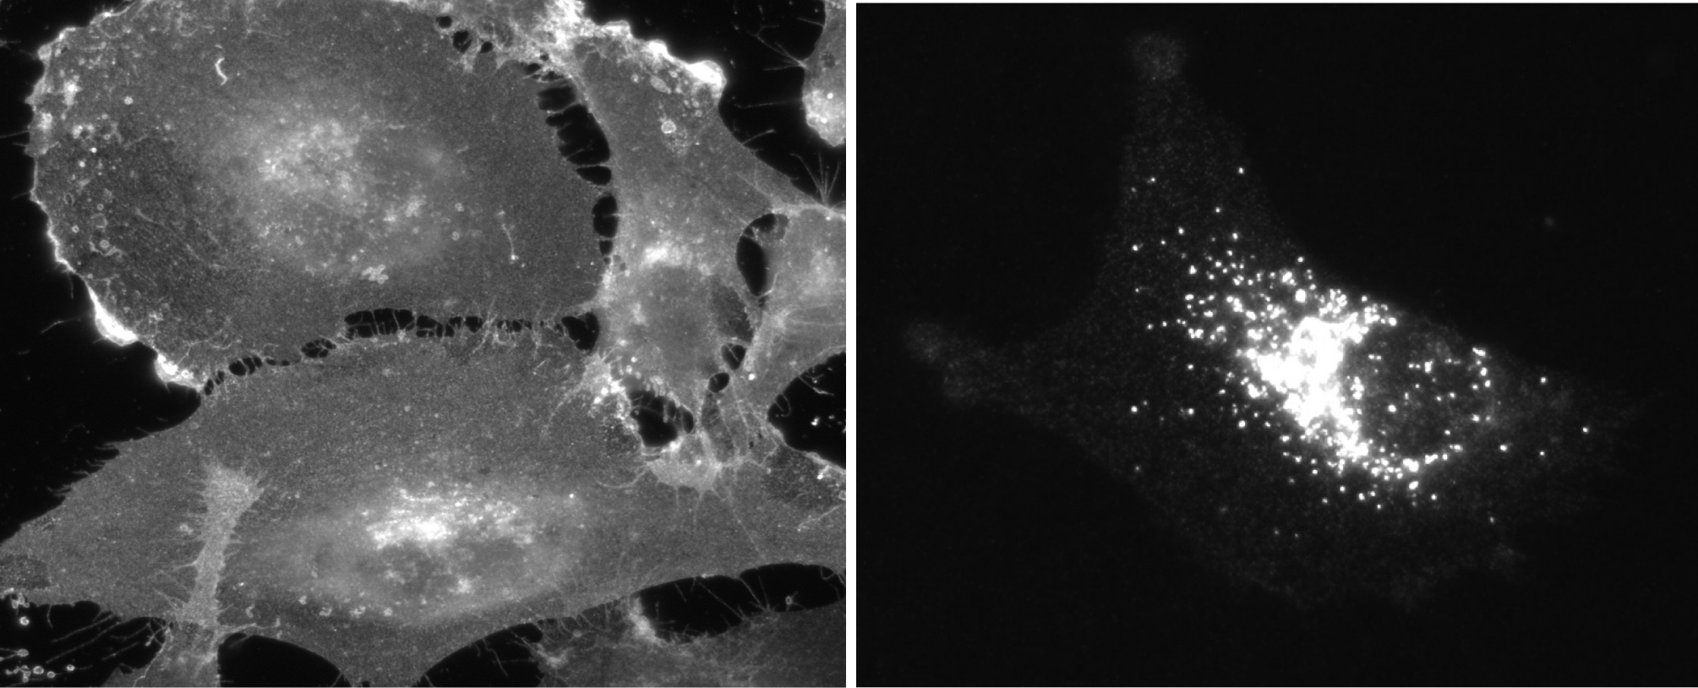
U21
Down regulation of MHC Class I

Slide 5
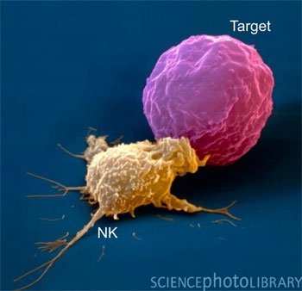
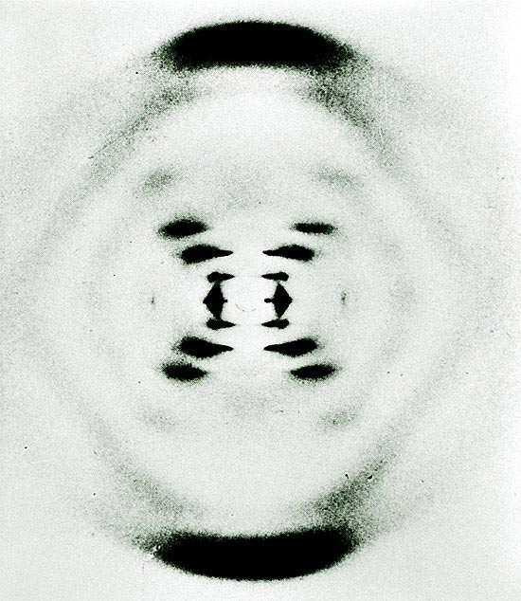
The Future
X-ray crystallization of MHC & U21
Diversion of MHC to lysosomal compartments
Alternate NK cell evasion

Slide 6
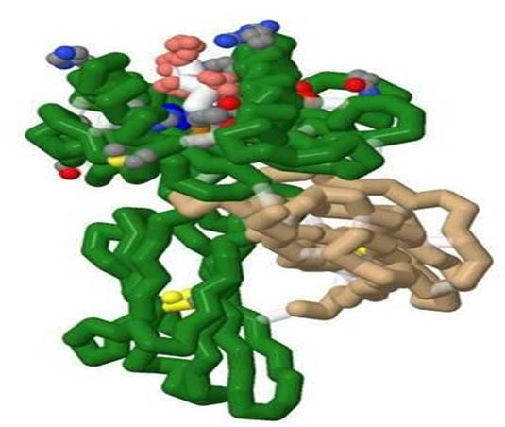
MHC in the Classroom
Model
- interactions
- anchor residues
- peptide presentation

