Slide 1
Conserved Through the Ages: GATA-1 and Friend of GATA-1 (FOG-1) Interactions with DNA
Student Researchers: Esmeralda Ambriz, Linnea Esberg,
Nicole Fischer, Amy Ramirez
Faculty Advisor: Dr. Colleen Conway
~Mount Mary College
Research Mentor: Dr. Michele Battle
~Medical College of Wisconsin

Slide 2
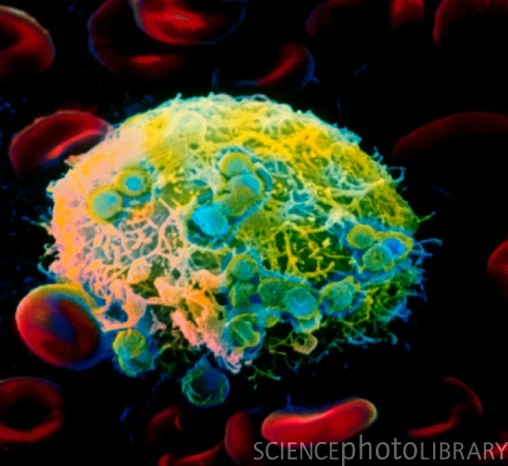
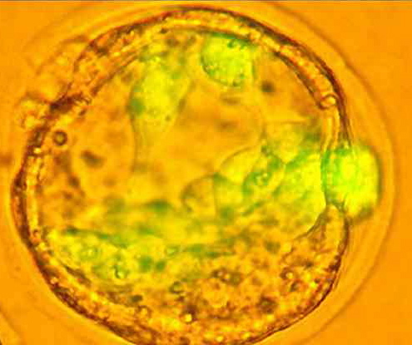
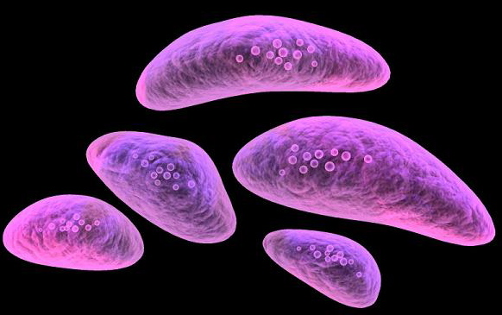
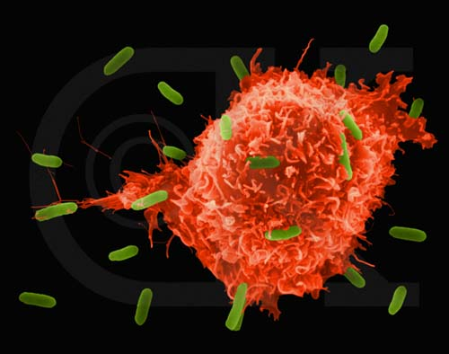
INTRODUCTION
6 GATA proteins
Zinc Fingers
Matured blood-hematopoietic stem cells
GATA-1 is a transcription factor
FOG-1
Mutations

Slide 3
HEMATOPOIETIC STEM CELL DIAGRAM

Slide 4
GATA-1 FOG-1 INTERACTION

Slide 5
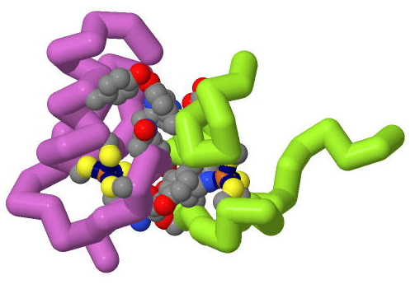
GATA-1/FOG-1 INTERACTIONS
Fruit fly U-Shaped and Mouse GATA-1 Zinc Finger

Slide 6
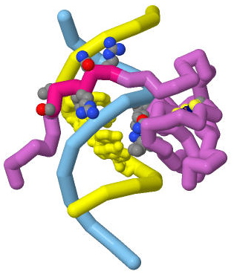
GATA-1/DNA INTERACTION
C-terminal Zinc Finger of Chicken GATA-1

Slide 7
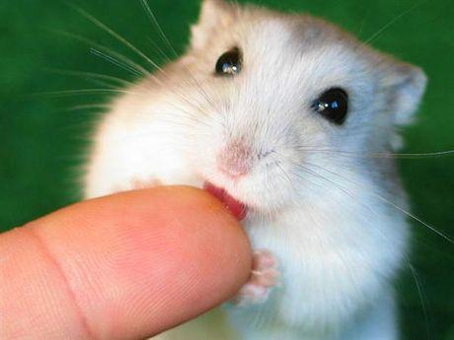
GATA-4 is Essential for Jejunal Function in Mice
70% similarity GATA-1 & GATA-4
Knockout Mice
GATA 4/6 Knockout
Importance of GATA functioning

Slide 8
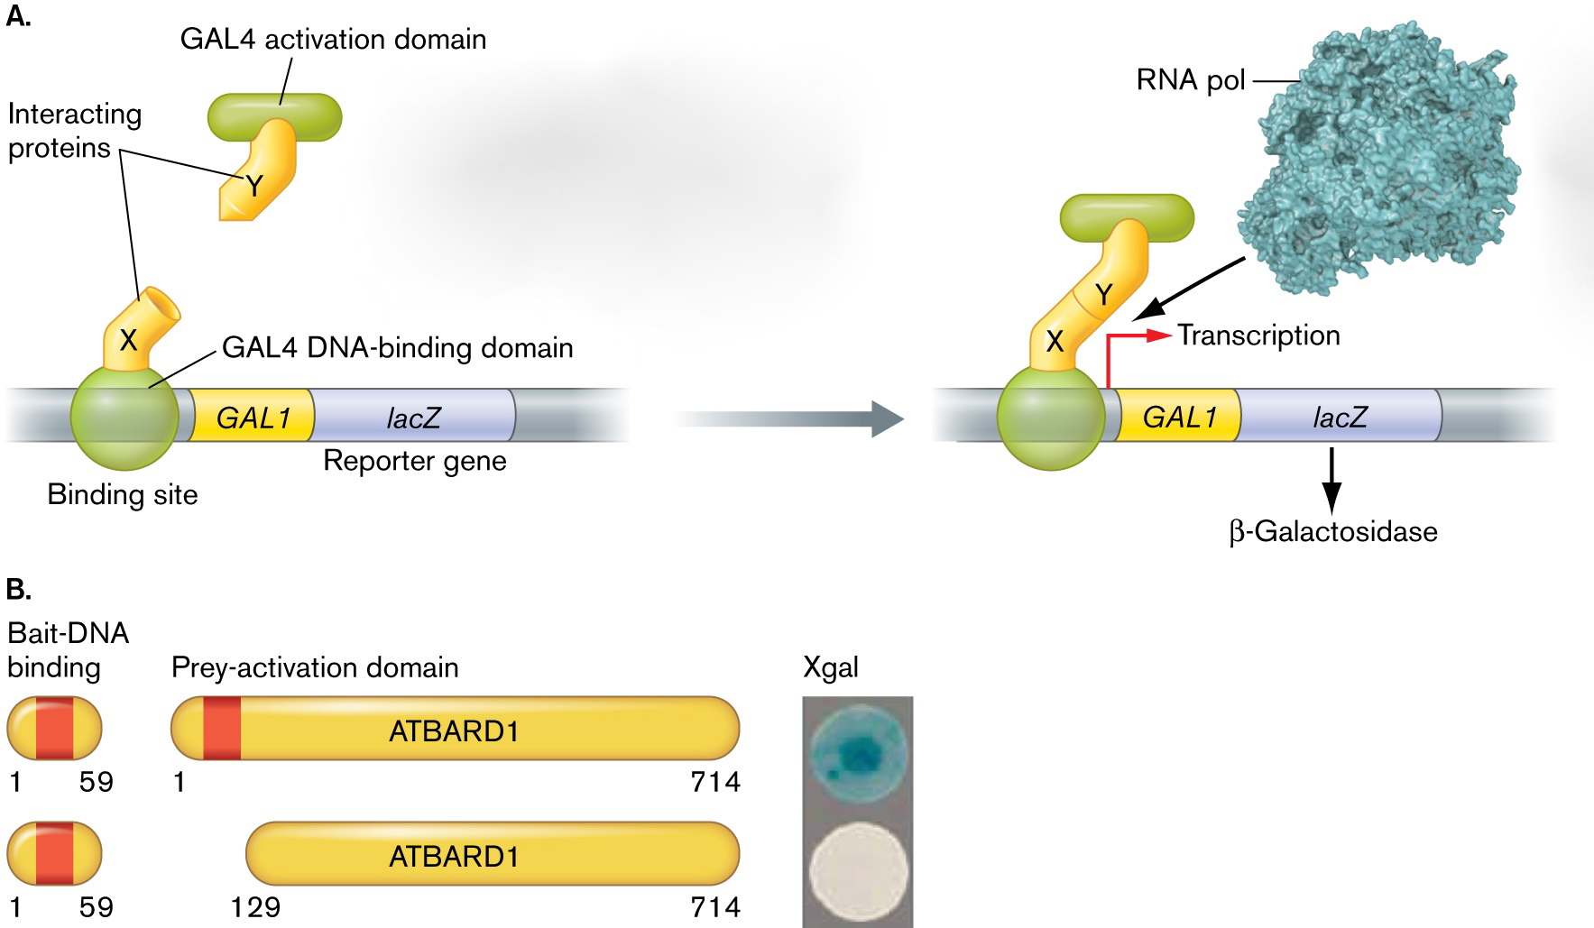
HOW DO WE KNOW?
*Slonczewski & Foster 2009
Yeast 2-Hybrid Assay

Slide 9
WHAT’S THE NEXT RESEARCH QUESTION?

Slide 10
REFERENCES
Cantor, A.B., et al. (2002). Distinct Domains of the GATA-1 Cofactor FOG-1 Differentially Influence Erythroid versus Megakaryocytic Maturation. Mol. Cell. Biol. 22 (12): 4268-4279.
Liew, C.K., et al. (2005) Zinc fingers as protein recognition motifs: structural basis for the GATA-1/friend of GATA interaction. Proc.Natl.Acad.Sci.Usa, 102 (3): 583-588.
Tjandra, N. Ominchinski, J.G., Gronenborn, A.M., Clore, G.M. (1991) Solution structure of the C-terminal domain of Chicken GATA-1 bound to DNA, NMR, regularized mean structure. Nat.Struct.Biol. 4: 732-738.
Vonderfecht,T.R.,et.al. (2008) Substitutions of DNA contacting amino acids with functional variants in GATA-1 zinc finger: A structurally and phylogenetically guided mutagenesis. Biochem. Biophy. Res. Comm. 269 (4) 1052-1056.
Distinct Domains of the GATA-1 Cofactor FOG-1 Differentially Influence Erythroid versus Megakaryocytic Maturation. Alan B. Cantor,1 Samuel G. Katz,1,2 and Stuart H. Orkin1,2. Mol Cell Biol. 2002 June; 22(12): 4268–4279.

Slide 11
Acknowledgments
MSOE’s Center for BioMolecular Modeling
Dr. Tim Herman and Dr. Margaret Franzen
This project was supported under the CREST Project funded by the National Science Foundation
Thank you to Dr. Michele Battle!!

Slide 12
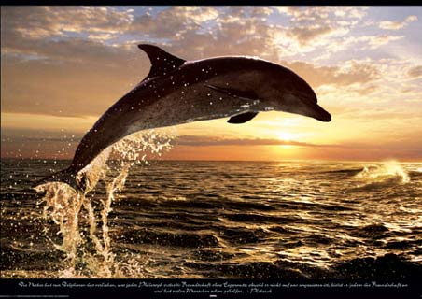
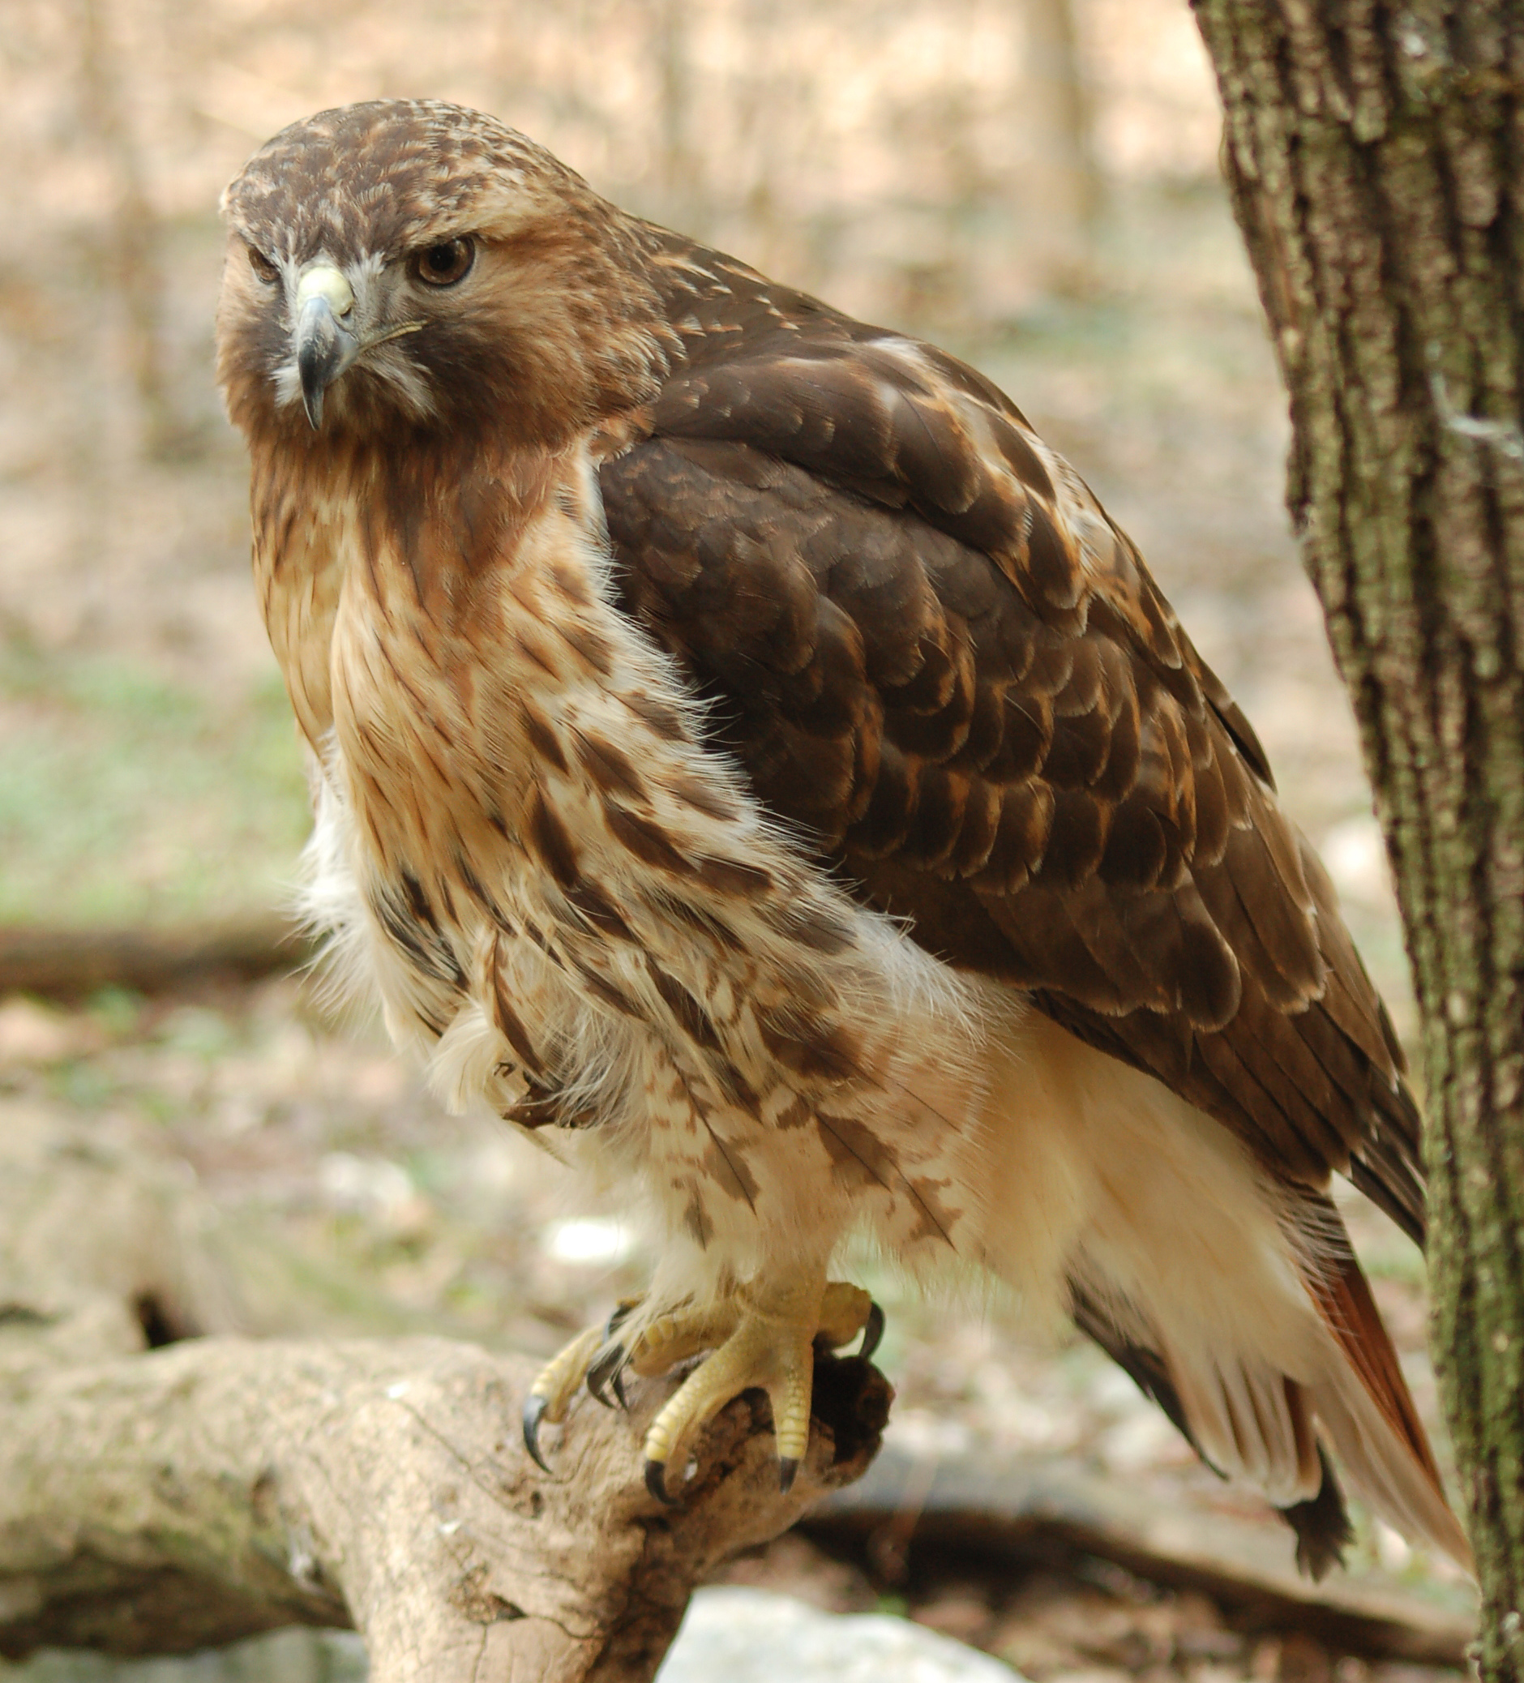
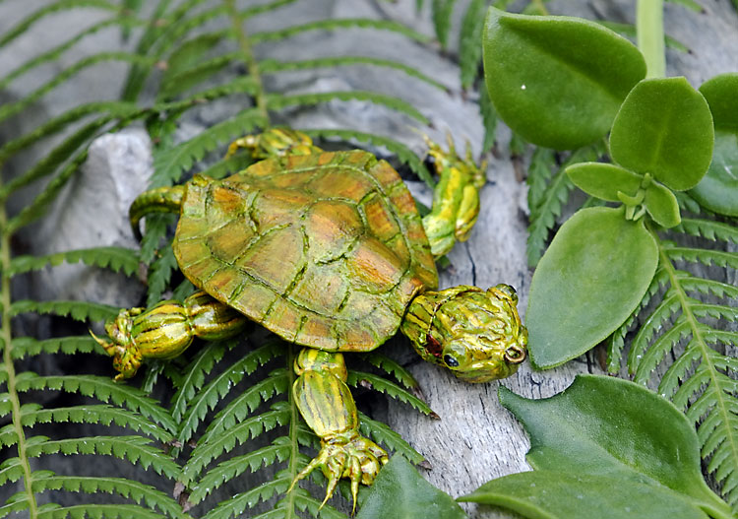
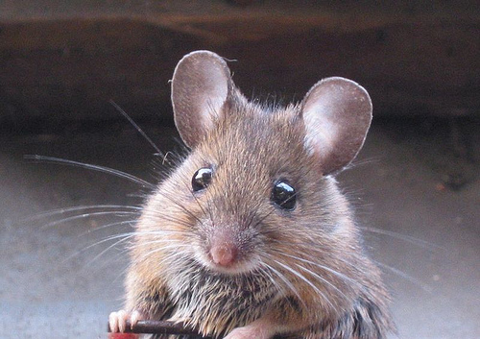
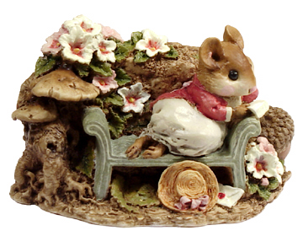
Questions?
Come see our poster!!!

