Slide 1
Drug Design for Inhibition of Extracellular Signal-regulated Kinase 2
Sam Klingbeil, Nicole Reiff and James Wagner

Slide 2
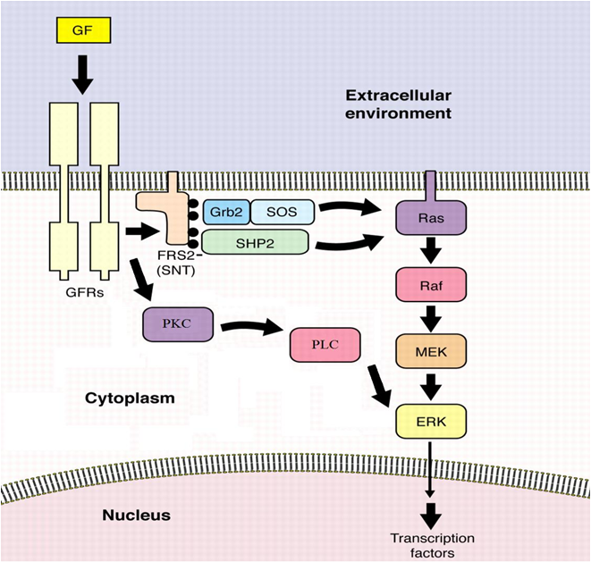
ERK2
ERK2 is part of a signaling cascade that results in neuronal differentation, mitogenesis, oncogenic transformation and apoptotic cell death.
In vascular endothelial cells, ERK activation typically leads to angiogenic sprouting
M. Goldfarb Sci. STKE. 2001, 106, pe37.
Figure 1. The upper pathway represents a typical example of a signaling cascade in which ERK-2 is involved in. The signaling cascade utilized by vascular endothelial cells is depicted by the bottom pathway

Slide 3
ERK2 Activity
ERK2 activity is regulated through control of the phosphorylation states of Thr185 and Tyr187
ERK2 is active when phosphorylated and inactive when dephosphorylated
ERK2 is phosphorylated by PLC and dephosphorylated by DUSP5
Constitutive action of the ERK2 Pathway has been reported in lung, colon, pancreatic, renal and ovarian cancers
An ERK2 inhibitor could potentially stop cell proliferation in tumors and prevent angiogenesis

Slide 4
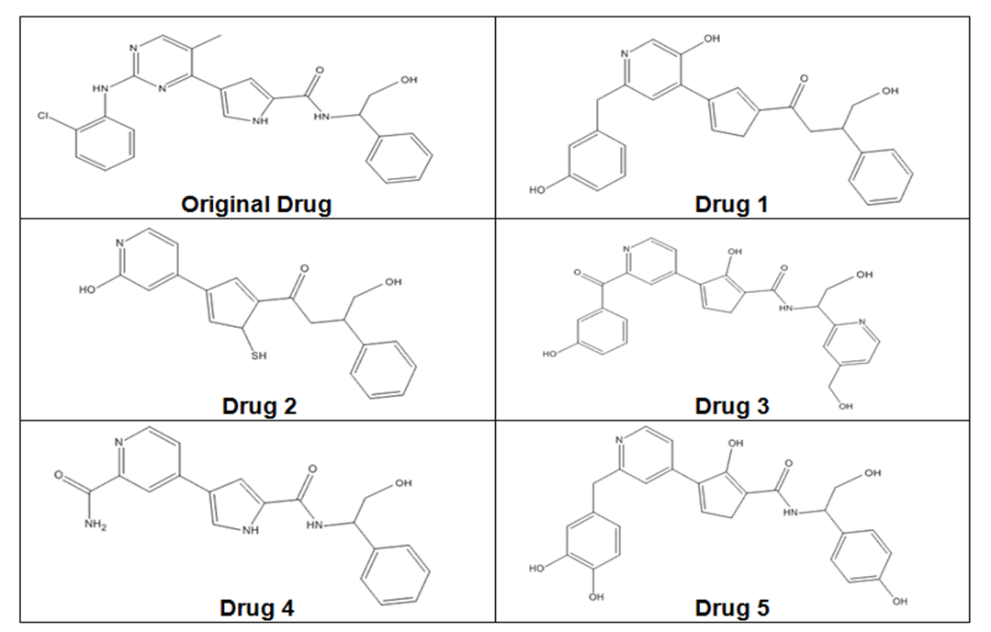
ERK2 Drug Design
A 2D representation of the ERK2 active site was created showing all the important potential amino acid interactions
From this drawing and from the Original Drug structure, 5 potential new drugs were created using DS Visualizer and Spartan.
The energy of each molecule was minimized in Spartan using a 3-21G basis set and the molecules were then fit into the active site of ERK-2 using DS Visualizer 3.0.
Figure 3. Inhibitors (Drug 1-5) designed using DS Visualizer and Spartan. Original Drug was designed by Aronov et al. and X-ray Crystallographic data was collected from ERK-2 with Original Drug bound in ERK-2 active site.

Slide 5
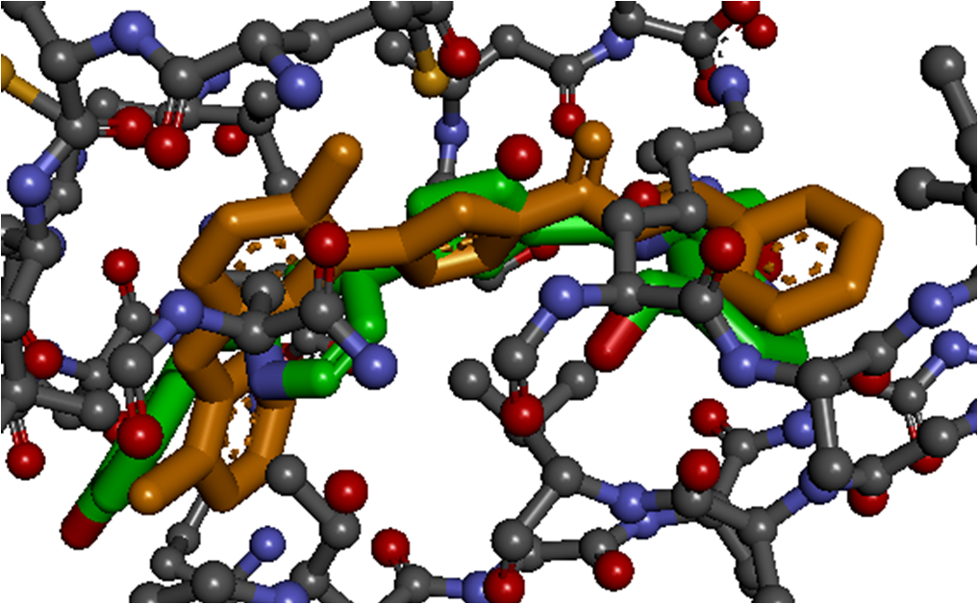
Drug 3 in the Active Site
Drug 3 was determined to have the highest compatibility in the active site.
Drug 3 forms a number of hydrogen bonds with ERK-2 including Lys52, Gln103, Asp165, Met106 and Leu105
There are Van der Waals interactions between Drug 3 and the aromatic ring of Tyr34.
Figure 5. 3D depiction of ERK-2’s active site with both the original drug (orange) and Drug 3 bound (green). Created using DS Visualizer.

Slide 6
Past Experiment
Fluorescence cross-correlation spectroscopy (FCCS) has been used to characterize the dephosphorylation of ERK2 by DUSP1 and DUSP5 in endothelial cells.
The effective interaction strength, K_{D}^{eff} was able to be determined through measurement of the observed fluorescence emissions.
This experiment found that DUSP5 had significantly higher interactions with ERK2 than DUSP1.

Slide 7
Future Experiment
We have designed a compound that could theoretically bind to the active site of ERK-2.
The next step in this process would be to assay the binding of Drug 3 and determine its K_{D}^{Eff}.
If successful, Drug 3 would enter into clinical testing in order to access its ability to be an effective inhibitor of ERK-2 in test subjects.

Slide 8
Educational Value
Explored the interactions between a protein and a substrate
Gave insight into the inhibitor design process
Enabled students to see the tertiary structures more clearly than images alone

