Slide 1
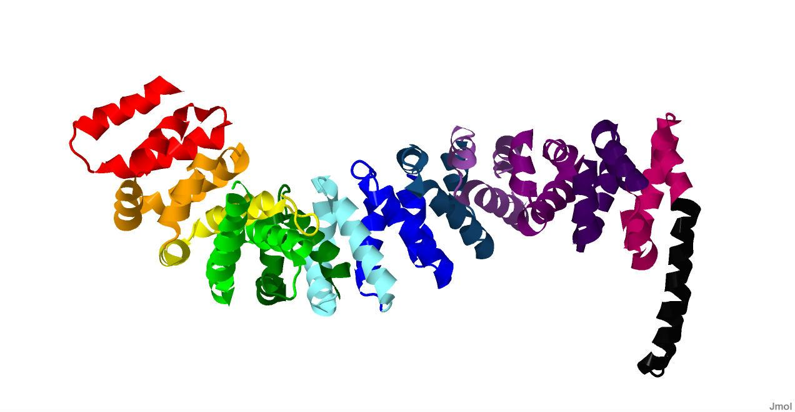
Beta Catenin: An Essential Player in Both Cell-Cell Adhesion and Wnt Transcriptional Regulation
By: Jim Heffernan, Ben Hierlmeier, Katie Strobel and Devan Van Lanen-Wanek

Slide 2
β-catenin
Structure
Role in cell
Structure determination
Future research
Educational objectives

Slide 3
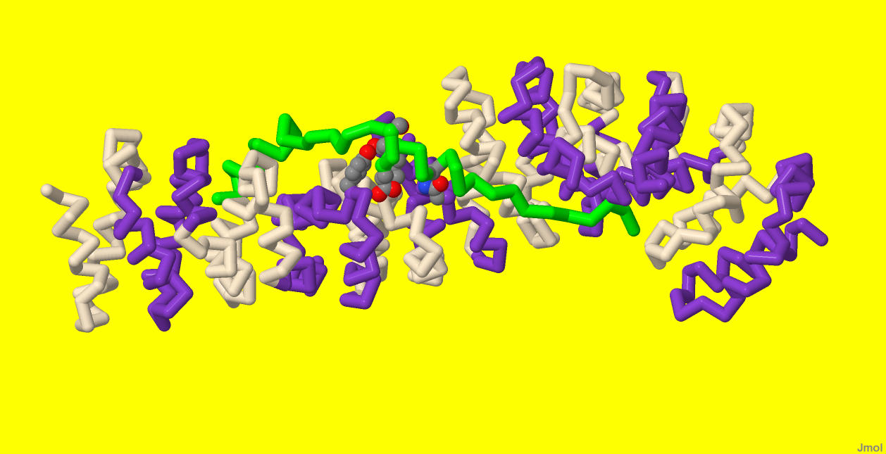
Beta Catenin Structure
Chromatin remodeling and transcriptional coactivators
Legless/Bc19
Tcf
α-catenin
axin-/APC
Charged button
149
664
667
691
683

Slide 4
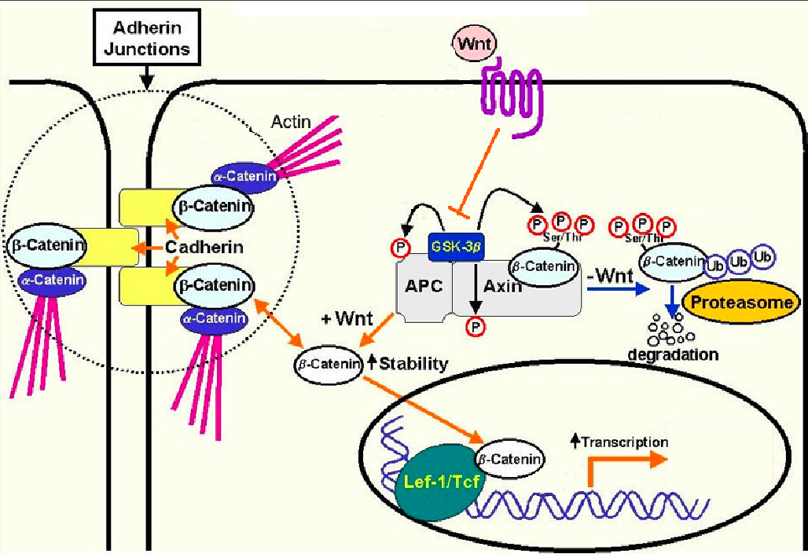
The Story
Hoover, A.B. 2005
Adherens
Adherens
Adherens

Slide 5
Methods

Slide 6
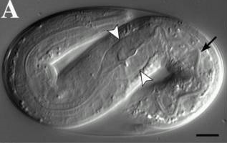
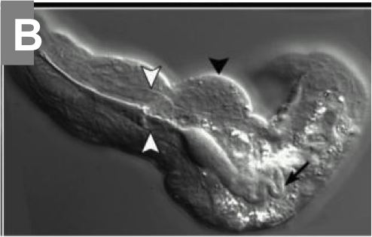
Future Research
Correlation of structure & function between β-catenin family proteins in C. elegans
BAR1 – Wnt pathway – C-helix
HMP2 – Adherens junctions – no C-helix
Does a fusion HMP2 with the BAR1 C-helix recover the phenotype in HMP2 mutants?
Figures A&B obtained from Costa et al. (1998)

Slide 7
Educational Objectives
Population: Students in Biology Core Curriculum program
Biocore 303 students
Physical model
Online tutorials I and II
Biocore 333 students
Online tutorial III
Physical model
Online Tutorials
Tutorial I: Secondary Structure of a Protein
Tutorial II: Cell-cell adhesion
Tutorial III: β-catenin, APC, and colon cancer

Slide 8
Works Referenced
Adam V. Kwiatkowskia, Stephanie L. Maidenb, Sabine Pokuttac, Hee-Jung Choic, Jacqueline M. Benjamina, Allison M. Lynchd, W. James Nelsona, William I. Weisc, and Jeff Hardin. In vitro and in vivo reconstitution of the cadherin–catenin–actin complex from Caenorhabditis elegans. PNAS, August 17, 2010. vol. 107 no. 33
Costa, M; Raich, W; Agbunag, C; Leung, B; Hardin, J; and Priess, JR (1998). A putative catenin-cadherin system mediates morphogenesis of the Caenorhabditis elegans embryo. J Cell Biology: 141 (1): 297-308.
Gottardi CJ & Peifer M (2008). Terminal regions of beta-catenin come into view. Structure: 16 (3): 478-487.
Graham, Thomas; Ferkey, Denise; Mao, Feng; Kimelman, David; and Xu, Wenqing (2001). Tcf4 can specifically recognize β-catenin using alternative conformations. Natural Structural Biology: 8(12); 1048-1052.
Hendrik C. Korswagen, Michael A. Herman, Hans C. Clevers. Distinct b-catenins mediate adhesion and signalling functions in C. elegans. Nature, vol 406, 3 August 2000
Huber, Andrew, and Weis, William (2001). The structure of the β-catenin/E-cadherin complex and the molecular basis of diverse ligand recognition by β-catenin. Cell: 105, 391-402.
Xing, Yi; Takemaru, Ken-Ichi; Liu, Jing; Berndt, Jason; Zheng, Jie; Moon, Randall; and Xu, Wenqing (2008). Crystal Structure of a Full-Length β-Catenin. Structure: 16; 478-487.
Hoover, B. A. (2005). Beta-catenin Mediated Wnt Signaling as a Marker for Characterization of Human Bone Marrow-Derived Connective Tissue Progenitor Cells, The Journal of Young Investigators, 12 (5) retrieved 21 April 2011 from http://www.jyi.org/research/re.php?id=190
Katharine Eklof Spink, Sofiya G.Fridman, William I.Weis. Molecular mechanisms of b-catenin recognition by adenomatous polyposis coli revealed by the structure of an APC±b-catenin complex . The EMBO Journal Vol. 20 No. 22 pp. 6203±6212, 2001
Ronen Zaidel-Bar, Michael J. Joyce, Allison M. Lynch, Kristen Witte, Anjon Audhya, and Jeff Hardin. The F-BAR domain of SRGP-1 facilitates cell–cell adhesion during C. elegans morphogenesis. Journal of Cell Biology. November 2008.

Slide 9
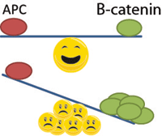
Special Thanks to:
Michelle Harris
Jeff Hardin
Tim Loveless and Elise Walck-Shannon
Margaret Franzen and Mark Hoelzer

